Slide 1
Weekly Review

Slide 2
Duolingo
Logan Cruz – 150 days
Alex Plitt – 125 days
Riley Rorrer, Friend Quest, except he stopped doing Duo weeks ago and I had to do the whole quest myself.

Slide 3
Duolingo
Why does Mr. Smith tell you to do Duolingo?

Slide 4
Bonus Submissions
Mac Hoover
Wrote a detailed description of whatever he did. Didn’t tell me where it lives on Github because he didn’t read the DocPac
Parker Fink
Made SmithPool, a pog-betting site where seniors can bet on whether they will get yelled at in the Weekly Review or not.
Also not on Github, because nobody reads these DocPacs. Seriously, why do I even go through all the stress of writing these DocPacs each week? I mean, if I had taken all of the time it took me to write these, then subtract the amount of time you spend reading them, and used that amount of time on other things, like curing cancer, there would be no more cancer.

Slide 5
Reflections
I dunno. I didn’t read them. I mean you don’t read anything I put in the DocPac, so why should I read anything YOU put in the DocPac?

Slide 6
My Reflection pt1
What is one technique thing you learned in coding teaching this week, and how will you use it in the future?
Write everything down. Instead of giving a lesson, give out a worksheet that can be kept as notes, THEN give a off-the-cuff lesson about that worksheet.
You’ll have the worksheet for next year. Even if you forget your Order of Study, you can piece it back together from all of the worksheets you did previously.
Students need multiple forms of engagement anyways, so you’re killing two birds with one stone.

Slide 7
My Reflection pt2
What was a challenge to your time management this week, and what can you do to avoid it in the future?
I just gave zero thought to when I was going to get my DocPacs graded. I’ve almost never left the school without the DocPacs in my backpack, but for some reason I just left without them.
Maybe I should start grading them in class on Friday and leave after they’re done. It worked in the past, but I can’t remember what else was happening that made it so effective that week.

Slide 8
My Reflection pt3
What opportunities did you NOT you take advantage of this week?
… … … … … …
I didn’t sell my Warhammer armies
I DID take pictures of random models I know I want to sell. About $500 worth.
I really want to play with my armies this week, but I should use my time listing the other stuff on eBay. The sooner I do, the sooner I can pay off the credit card I used for the new models. Interest on that card alone is about one box of Warhammer.
I’ve also ignored quite a few emails last week. I need to follow up with everything immediately.

Slide 9
This week / Loose Ends
Read the DocPac
If there is an error in the DocPac, message me, then FIX it and open a PR.
I haven’t graded two weeks of DocPacs. Oops!

Slide 10
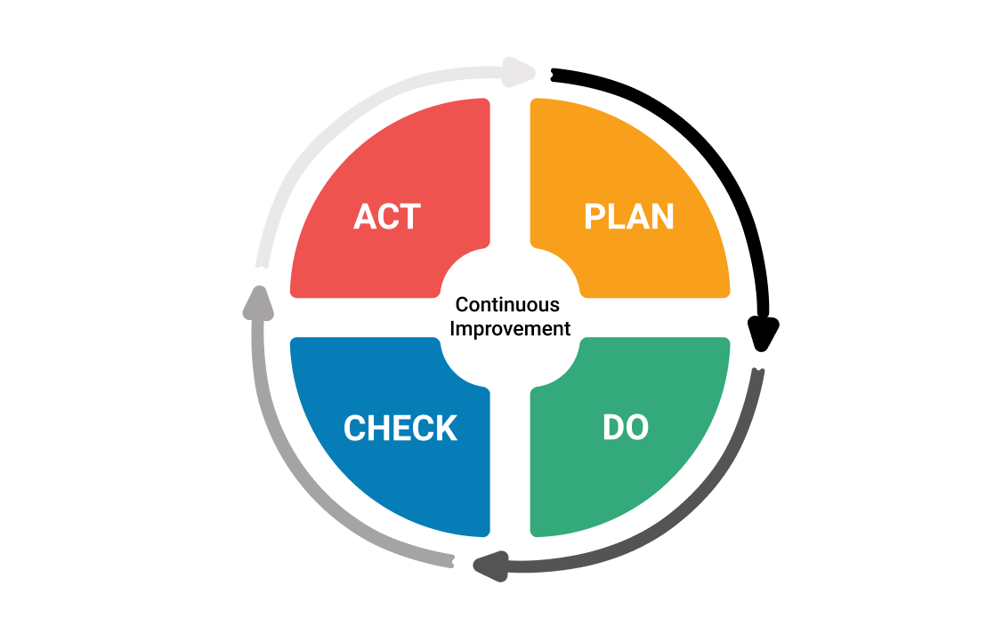
Continuous Improvement

